Slide 1
Character Classifier Project
By: Cody Nicholson & Adam Gruszczynski

Slide 2
Problem Statement
The ability to program a computer to classify objects found in images has been a very popular topic in the machine learning & data science communities as of lately. This is because, by teaching a program to understand the world around it, we are closer than we have ever been to solving intelligence. In the words of Google’s AI Lead Developer Demis Hassabis: “creating a general artificial intelligence—something that, like a human, can learn to take on just about any task”.
To get closer to achieving this goal we chose to create an image classifier using a deep convolutional neural network
Problem Statement
Notes:
https://www.technologyreview.com/s/601139/how-google-plans-to-solve-artificial-intelligence/

Slide 3
Why is this important?
Solving intelligence will give us the power to solve just about any problem we put our minds to. Hassabis envisions AI being able to do things: “as diverse as advancing medicine by formulating and testing scientific theories, and bounding around in agile robot bodies”.
The applications of image classification, as we have seen in the professor’s examples, could be detecting diseases given images of a person’s x-ray or MRI results. It is also being used heavily in self-driving car technology that will eventually make car accidents all but disappear. We also see image classification working in popular social media applications like facebook and snapchat.
Why it is important
Notes:
https://www.technologyreview.com/s/601139/how-google-plans-to-solve-artificial-intelligence/

Slide 4
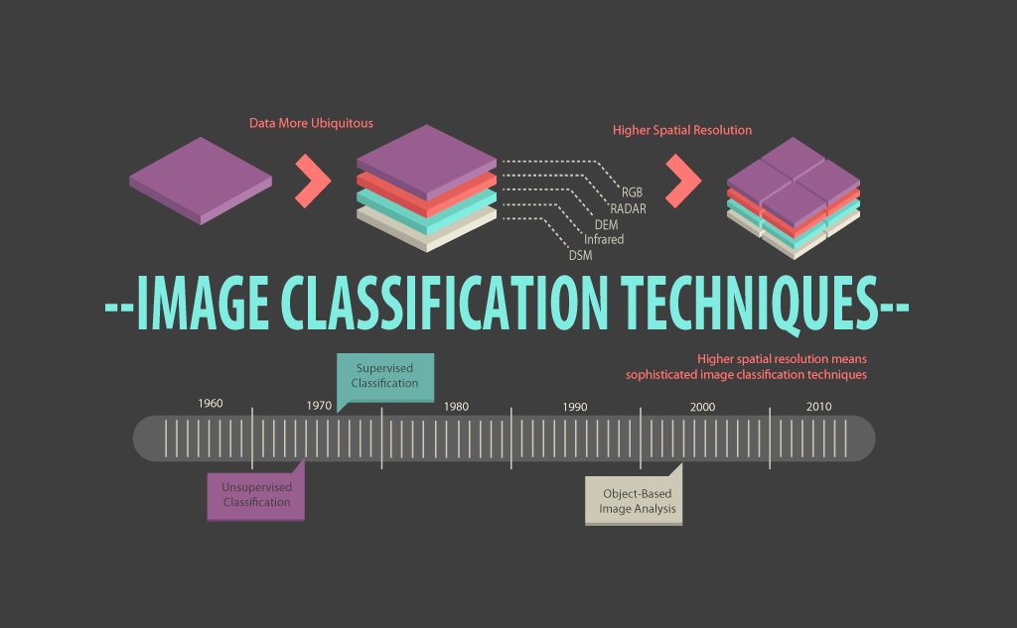
A Survey On Image Classification Approaches & Techniques
The first paper we reviewed was “A Survey on Image Classification Approaches and Techniques” by Pooja Kamavisdar, Sonam Saluja, and Sonu Agrawal written in January of 2013. We used this paper early on in our project to review all of the different methods we could use to build our image classifier.
The paper talks about using artificial neural networks, decision trees, support vector machines, and k-means among other methods
We chose to build an artificial neural network, since they have caught a lot of attention in the data science community recently
Related Work

Slide 5
Related Work Continued
In the “A Survey on Image Classification Approaches and Techniques” article we read all about the advantages and disadvantages of creating an artificial neural network.
The advantages included: It is a non-parametric classifier, it is an universal approximator with arbitrary accuracy, it is capable to present functions such as OR AND & NOT, it is a data-driven self-adaptive technique, it efficiently handles noisy inputs, and the consumption rate is high
The disadvantages include: It is hard to understand, it takes a long time to train, it is prone to overfitting, it is difficult to choose the type of network architecture
Related Work
Notes:
Nonparametric methods are good when you have a lot of data and no prior knowledge, and when you don’t want to worry too much about choosing just the right features.

Slide 6
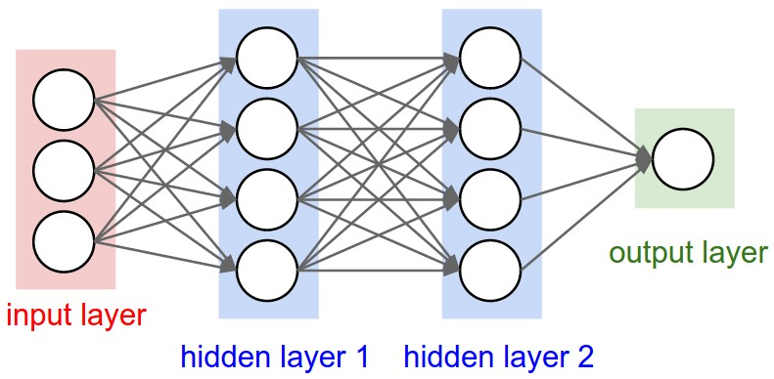
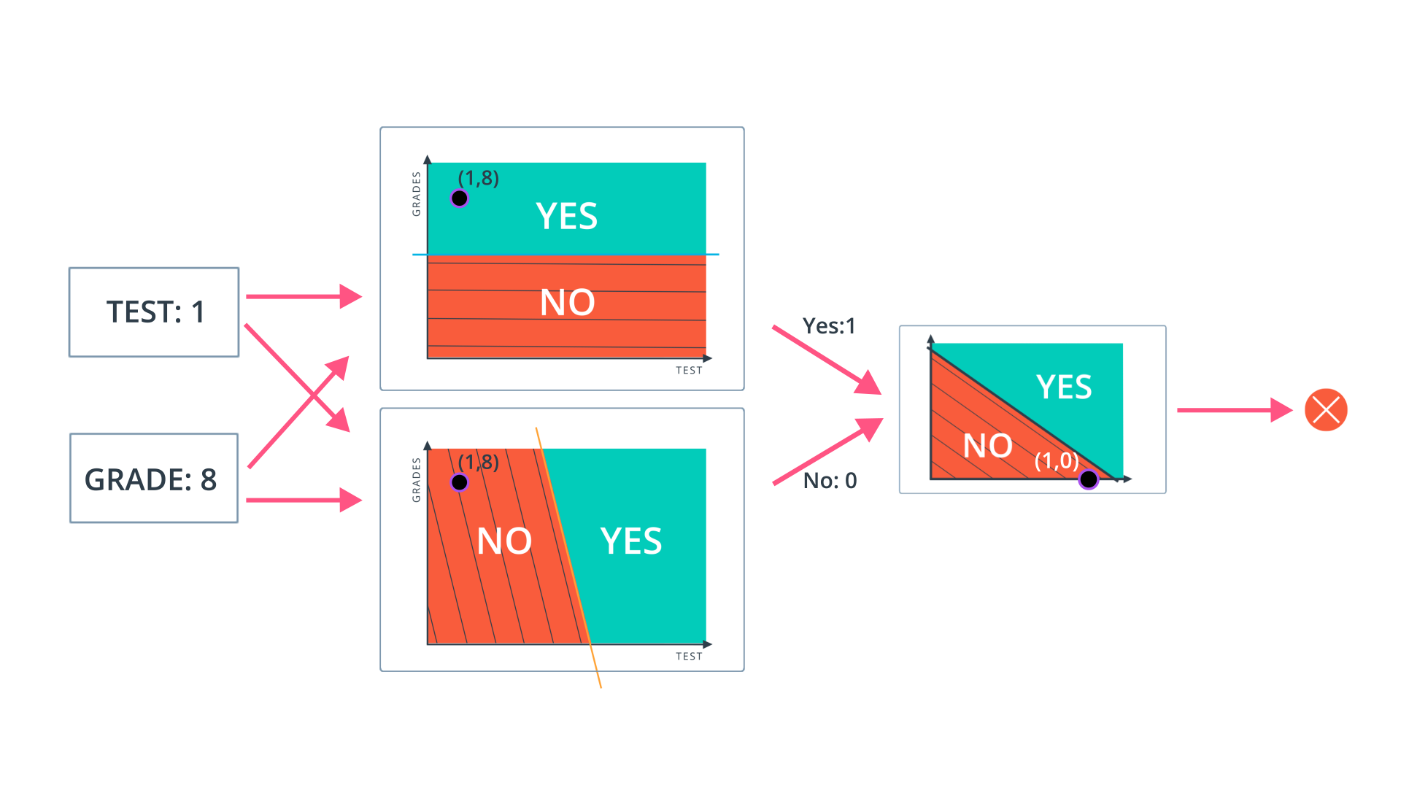
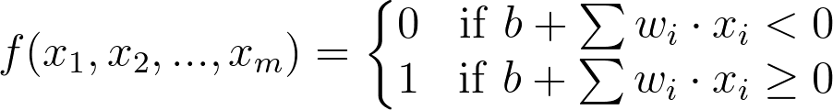
What is an Artificial Neural Network?
An ANN is a type of supervised learning that consists of a sequence of layers, each layer consists of a set of neurones. All neurones of every layer are linked by weighted connections to all neurons on the preceding and succeeding layers. Neural Networks receive an input (a single vector), and transform it through a series of hidden layers. Each hidden layer is made up of a set of neurons, where each neuron is fully connected to all neurons in the previous layer, and where neurons in a single layer function completely independently and do not share any connections. The last fully-connected layer is called the “output layer” and in classification settings it represents the class scores.
Neural network overview
Notes:
Compare to decision tree and talk about how the images get more and more specific features as they go through the network and support:
Feature selection, Density estimation, Classification, Anomaly detection, Reinforcement learning, Self learner NN with recurrent NN, Time series based learning (like stock price prediction)
But it takes longer to train than a decision tree, and there is a lot of parameter tuning involved
Weights is w, biases is b

Slide 7
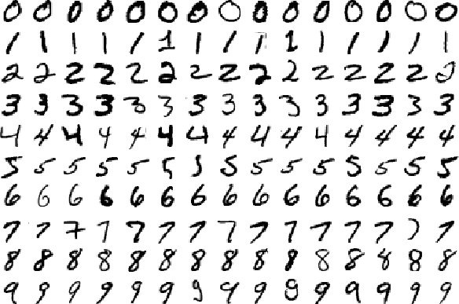
Domain Understanding & Data Collection
We wanted to classify images as the digits that they are, so we chose to use the MNIST dataset of hand-drawn digits to train our algorithm. You can see an example of a subset of the dataset in the picture below.
The dataset consists of 70000 samples. We divided these samples into groups (Data hold out). A training set of 55000, a testing set of 10000, and a validation set of 5000.
The shape of each individual sample was 28x28x1 (width by height by color channel)
Related Work & Methodology

Slide 8
Data Preprocessing
After loading our data we begin preprocessing by transforming our samples by padding them with zeros to change them from 28x28x1 images to 32x32x1 images. This was necessary because the model architecture we chose to implement requires samples to be this size.
Once the images are the correct size we shuffle the dataset so that when we train our model it does not rely on the order of the samples. This prevents overfitting.
The MINST dataset does not need data cleaning or integration because it has already been done by the creators of the dataset, but as we said above it did need to be transformed.
Lastly, before training we set our EPOCHS to 10 and our Batch Size to 128. One EPOCH means one iteration of training. Our Batch Size tells the model how many samples to run through the network at a time. A large batch size will train faster, but it will strain the computer’s processor more.
Related Work & Methodology

Slide 9
Data Reduction
Since our images are all from the MINST dataset, we don’t need to worry about reducing the number of samples since they are all valid. However, we do need to make sure that - since there are only 10 digits we want to classify - we use dimensionality reduction. Specifically, we want to use Feature Selection, and to do this, we use a technique called One-Hot Encoding.
One-Hot encoding transforms categorical features to a format that works better with classification and regression algorithms. It assigns a numeric label to each one of the classes we use to classify images. For example, if we were to classify traffic signs, the class “Stop Sign” might be encoded as “0” and “Yield” as “1”, and so on.
Our class labels for the digits are the digits 0-9 themselves - 10 classes
Related Work & Methodology
Notes:
What’s nice about neural networks is that they can learn features on their own. If you remember, in assignment 3 we made decision trees having been given the attributes like “average number of rooms per dwelling” and “% lower status of the population”.

Slide 10
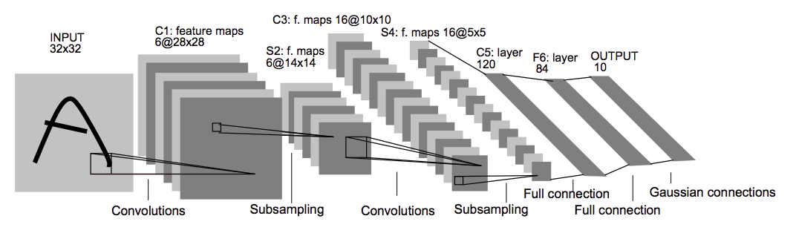
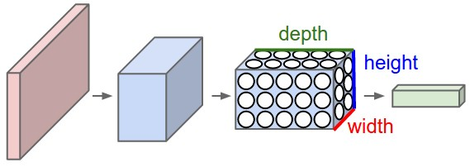
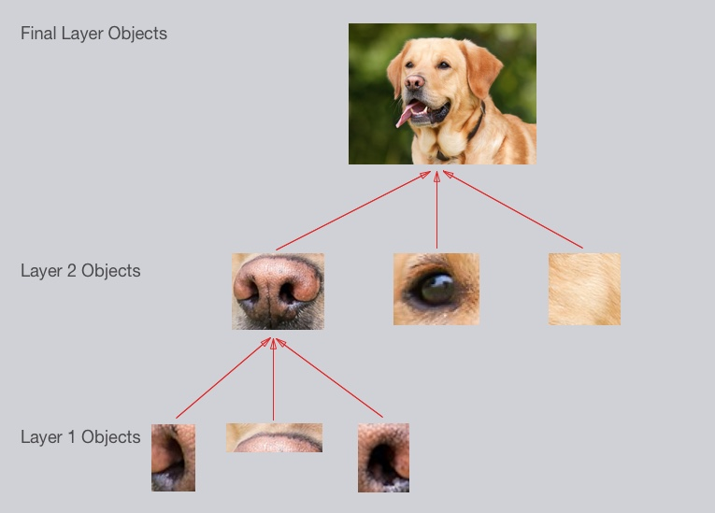
Pattern Discovery
In order to discover patterns we engineered a model (or pipeline) for all of our samples to go through that uses a convolutional neural network inspired by Yann LeCun’s paper “Gradient-Based Learning Applied to Document Recognition”. The CovNet parses through each sample image and for every patch/kernel it outputs a new image with different dimensions. This operation is called a Convolution. If your patch/kernel size was the entire image, it would output the same as a regular neural network.
Instead of having stacks of matrix multipliers, in a CovNet we have stacks of convolutions. The idea is that these stacks will form a pyramid like the one in the image above. At the base of the pyramid is the input image, and at the peak is the output. This output is a representation where all the spatial information has been removed, and only parameters that map to content remain.
Related Work & Methodology

Slide 11
Evaluation & Learning Rate Comparisons
To evaluate our algorithm we used the training set to train our model, then we used both a testing and validation set to evaluate the trained model.
We were interested in seeing how the learning rate we used to train our model would affect our results if we changed its value. Here is the results:
With a learning rate of 0.001, test accuracy was 99%, validation accuracy was 99.1% With a learning rate of 0.01, test accuracy was 98.7%, validation accuracy was 98.4% With a learning rate of 0.1, test accuracy was 11.4%, validation accuracy was 11.3%
A higher learning rate means the model will learn faster but with lower quality. A lower value will make it learn slowly with a higher quality. Thus, the lowest learning rate was the best of the three. Just like when we train ourselves to do new things, neural networks learn best given plenty of time and practice.
The model we created and trained in this experiment can be used to classify any images of hand-drawn digits,as we saw with the results from the testing and validation sets. Instead of discovering knowledge, it is more accurate to say that we have created a tool using data science techniques that has many applications.
Related Work & Methodology

Slide 12
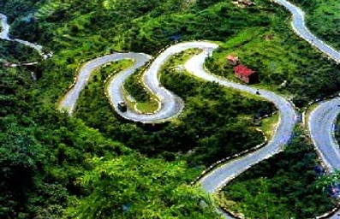
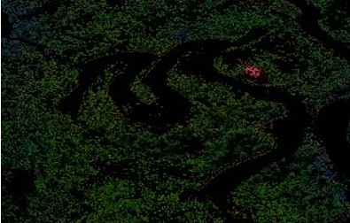
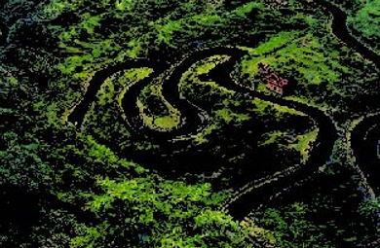
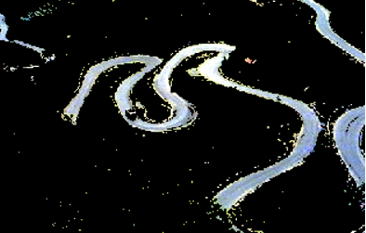
Image Classification Using K-Means
For our second algorithm we chose to build a model using k-Means to classify the same set of images. We got our idea by reading the research paper “Image Classification through integrated K- Means Algorithm”
Using K-Means we can divide the image into different partitions based on the image RGB values. In the example below you can see the original image divided into clusters of red, green, and blue.
Original
Cluster Red
Cluster Green
Cluster Blue
Evaluation
Notes:
General idea of k-means, but in our algorithm we only have black and white

Slide 13
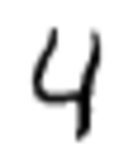
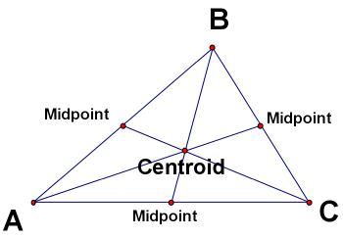
K-Means For Clustering
First our model determines the centroid coordinate. The centroid coordinate is simply the center of the digit in the image relative to its size. See how the centroid is found for the triangle on the top right? We do that same operation for each digit.
Then it determines the distance of each object pixel to the centroids. This means we will collect a list of all the distances from the centroid to each non-white pixel in the image.
Lastly, it groups the object based on minimum distance to other centroids. Based on these minimum distances we can cluster the digit that is in our image.
It will repeat this process until it finds convergence (the answer).
Evaluation

Slide 14
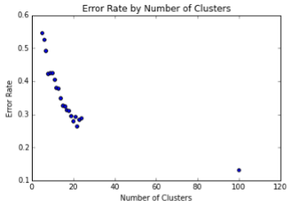
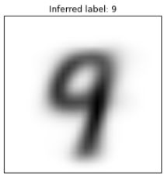
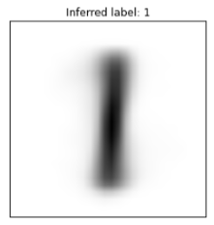
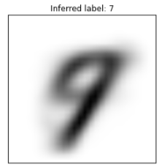
K-Means Evaluation
We found that the more clusters we defined, the more “accurate” our model would be. We think that this increase in accuracy is the result of overfitting because we should only need 10 clusters, one for each digit. The more we continue to divide our data, the more “accurate” we get, but that is because it learns the dataset instead of the difference between digits.
This model could be improved, but the neural network is a better model overall since we can train it by showing it samples with their correct labels instead of relying solely on the math in our unsupervised K-Means algorithm.
Evaluation

Slide 15
Knowledge Discovery & Future Work
This tool can be used in many different scenarios where it would be beneficial to have a computer read text.
There is an unlimited amount of potential for future work because our model can easily be tweaked to work for facial detection, classifying traffic signs, classifying famous pieces of art, etc.
We could also improve our k-Means model by adding an SVM to help classify
To take an even more ambitious step we could use this as a starting point to build a Generative Adversarial Network that would be even more accurate and adaptive to change than the one we currently have.
Conclusion
Notes:
https://codynicholson.github.io/Character_Classifier_Project/

Slide 16
References
“Image Classification through integrated K- Means Algorithm”, Balasubramanian Subbiah et al. March 2012
“A Survey on Image Classification Approaches and Techniques”, Pooja Kamavisdar et al. January 2013
“Gradient-Based Learning Applied to Document Recognition”, Yann LeCun et al. November 1998

